Slide 1

GAME ANALYSIS FRAMEWORKS
CHAPTER 02

Slide 2
Topics
Common Frameworks for Ludology
  MDA: Mechanics, Dynamics, and Aesthetics
  Formal, Dramatic, and Dynamic Elements
  Elemental Tetrad

Slide 3
MDA: Mechanics, Dynamics, & Aesthetics
Proposed at the Game Developers Conference (2001)
Formalized in "MDA: A Formal Approach to Game Design and Game Research"
  Robin Hunicke, Marc LeBlanc, Robert Zubek (2004)
Most well known framework for game analysis
Three elements:
  Mechanics: The particular components of the game at the level of data representation and algorithms
  Dynamics: The runtime behavior of the mechanics acting on player inputs and each other's outputs over time
  Aesthetics: The desirable emotional responses evoked in the player when she interacts with the game system

Slide 4

MDA: Mechanics, Dynamics, & Aesthetics
Designers and players view games from different directions
  Designers first consider the aesthetic feelings that they want players to experience
    Then consider the dynamic play that will engender these aesthetics
    Finally create mechanics that will lead to these dynamics
  Players first read the rules of the game (mechanics)
    These rules lead to dynamic play
    The dynamics engender aesthetic feeligns

Slide 5
Formal, Dramatic, and Dynamic Elements
From Game Design Workshop by Tracy Fullerton
  Formal elements: The elements that make games different from other forms of media or interaction and provide the structure of a game. Formal elements include things like rules, resources, and boundaries.
  Dramatic elements: The story and narrative of the game, including the premise. Dramatic elements tie the game together, help players understand the rules, and encourage the player to become emotionally invested in the outcome of the game.
  Dynamic elements: The game in motion. Once players turn the rules into actual gameplay, the game has moved into dynamic elements. Dynamic elements include things like strategy, behavior, and relationships between game entities.

Slide 6
Formal, Dramatic, and Dynamic Elements
A game ceases to be a game if the formal elements are removed
Seven formal elements of games
  1. Player interaction pattern: How do the players interact?
    Single-player
    One-on-one
    Team versus team
    Multilateral (multiple players versus each other)
    Unilateral (one player versus all the other players)
    Cooperative play
    Multiple individual players each working against the same system
  2. Objective: What are the players trying to achieve in the game? When has someone won the game?

Slide 7
Formal, Dramatic, and Dynamic Elements
Seven formal elements of games
  3. Rules: Limit the players' actions by telling them what they may and may not do in the game.
    Many rules are explicit, but others are implicitly understood
  4. Procedures: Actions taken by the players in the game
    A rule tells the player what to do
    The procedure dictated by that rule is the actual action of the player
    Procedures are often defined by the interaction of a number of rules
    Some procedures are also outside of the rules: Bluffing in Poker
  5. Resources: Elements that have value in the game
    Money
    Health
    Items
    Property

Slide 8
Formal, Dramatic, and Dynamic Elements
Seven formal elements of games
  6. Boundaries: Where does the game end and reality begin?
  "A game is a temporary world where the rules of the game apply rather than the rules of the ordinary world" – Johan Huizinga, Homo Ludens (1955)
    This concept is now known as the Magic Circle
    In a sport like football or ice hockey, the magic circle is defined by the boundaries of the playing field
    In an Alternative Reality Game like I Love Bees (the ARG for Halo 2), the boundaries are more vague
  7. Outcome: How did the game end?
    Both final and incremental outcomes
    In Chess, the final outcome is that one player will win, and the other will lose
    In an RPG, there are several incremental outcomes

Slide 9
Formal, Dramatic, and Dynamic Elements
Dramatic elements of games
  Make the rules and resources more understandable
  Give players greater emotional investment in the game
Three dramatic elements of games
  1. Premise: The basic story of the game world
    Monopoly: The players are real-estate developers trying to get a monopoly on corporate real estate in Atlantic City, New Jersey
    Donkey Kong: The player is trying to single-handedly save his girlfriend from a gorilla that has kidnapped her
    The premise forms the basis around which the rest of the game's narrative is built

Slide 10
Formal, Dramatic, and Dynamic Elements
Three dramatic elements of games
  2. Character: The individuals around whom the story revolves
    Vary widely in depth
      The main character of Quake is nameless and largely undefined
      Nathan Drake, from the Uncharted games, is as deep and multidimensional as the lead characters in most movies
    In movies, the goal of the director is to encourage the audience to have empathy for the film's protagonist
    In games, the player actually is the protagonist character
    Designers must choose whether the protagonist will act as
      An avatar for the player
      A role that the player must take on
        Most common of the two
        Much simpler to implement.
  3. Story: The plot of the game
    The narrative that takes place through the course of the game

Slide 11
Formal, Dramatic, and Dynamic Elements
Dynamic elements of games
  Occur only when the game is being played
Core concepts of dynamic elements
  Emergence
    Simple rules lead to complex and unpredictable behavior
    One of a game designer's most important jobs is to attempt to understand the emergent implications of the rules in a game.
  Emergent narrative
    Narrative can also be dynamic
    Narratives can emerge from the gameplay itself
    One of the central appeals of RPGs like Dungeons & Dragons
    Different from the narrative embedded in cut scenes and plot
    Unique to interactive experiences.

Slide 12
Formal, Dramatic, and Dynamic Elements
Core concepts of dynamic elements
  Playtesting is the only way to understand dynamics
    Game systems are unpredictable
    Experienced game designers can make better guesses
    But, everyone must playtest to understand a game

Slide 13
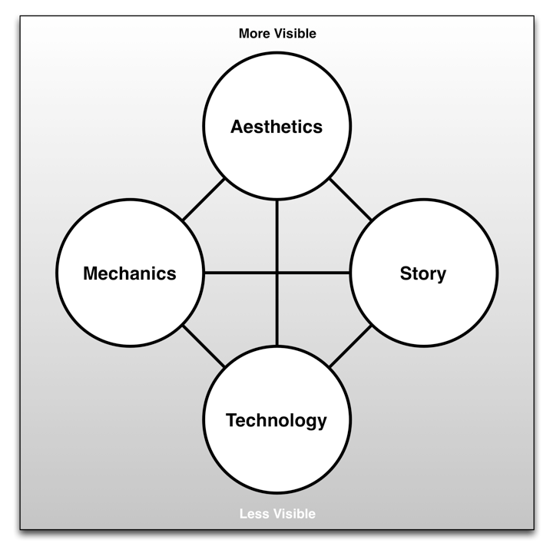
The Elemental Tetrad
From The Art of Game Design: A Book of Lenses by Jesse Schell
A tetrad of elements

Slide 14
The Elemental Tetrad
Mechanics
  Rules for interaction between the player and the game
  Differentiate games from other non-interactive media
  Contain
    Rules
    Objectives
    Other Formal elements
  Different from mechanics in MDA
    Schell differentiates between mechanics and technology

Slide 15
The Elemental Tetrad
Aesthetics
  Describe how the game is perceived by the five senses
    Vision
    Sound
    Smell
    Taste
    Touch
  Many different aspects of aesthetics
    Soundtrack
    3D graphics and animation
    Packaging and cover art
  Different from aesthetics in MDA
    MDA aesthetics describes the emotional response to the game
    Schell's aesthetics describe the five senses

Slide 16
The Elemental Tetrad
Technology
  The underlying technology that makes the game work
  Digital technologies
    Computer and console hardware
    Software and programming
    Rendering software and pipelines
  Paper technologies
    Dice and other randomizers
    Statistics tables

Slide 17
The Elemental Tetrad
Story
  Everything included in Fullerton's Dramatic Elements
  Differs from Fullerton's Dramatic Elements because it is broader than what she terms story.
    Schell's story includes premise and character as well

Slide 18
The Elemental Tetrad
Schell arranges the elements in a tetrad
  Four elements also represent four groups in a game studio
  Arranged from most to least visible

Slide 19
Chapter 2 – Summary
Each framework has a different perspective
  MDA demonstrates that gamers and designers approach games from different directions
    Encourages designers to see games from the perspective of players
  Formal, Dramatic, & Dynamic breaks games down into specific components that can be isolated, tweaked, and improved
  Elemental Tetrad views games from the perspective of a development studio
Next Chapter: The Layered Tetrad
  The Layered Tetrad attempts to bring these schools of thought together into a more complete theory

